Slide 1


TinyP2P
Developing a Purely Decentralized File Sharing System
Nicky Reid
Supervisor: Yusuf Motara

Slide 2
Usability
Appropriateness to purpose
Relative ease in learning and remembering to use

Slide 3

Usability: Appropriateness to purpose
Examine intended use for application
aims to facilitate file sharing among task- or interest- related groups

Slide 4
Usability: Learning and remembering to use
Examine intended user base
Non-experts
  Project collaboration
  Media sharing among friends
  Distribution of work or academic files

Slide 5
TinyNets
Ad-hoc file sharing network
  Created when needed
  Dies after use
Friend-to-Friend
Purely decentralized

Slide 6
Decentralization
purely decentralized
Uses IP addresses to set up TinyNets
Does not rely on any central server
Uses a system of Mnemonics to abstract the idea of IP addresses to facilitate connection

Slide 7
Mnemonics
Abstract IP addresses
Easier to remember and communicate
4-word sentence made up of 3-letter words
  127.0.0.1 → “lab zip zip ace”
  192.168.123.213 → “lol out key sip”
  48.92.14.78 → “die had bad fox”

Slide 8
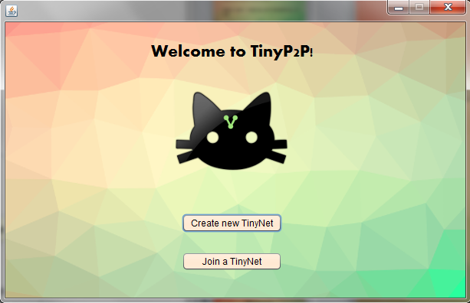
Getting Started

Slide 9
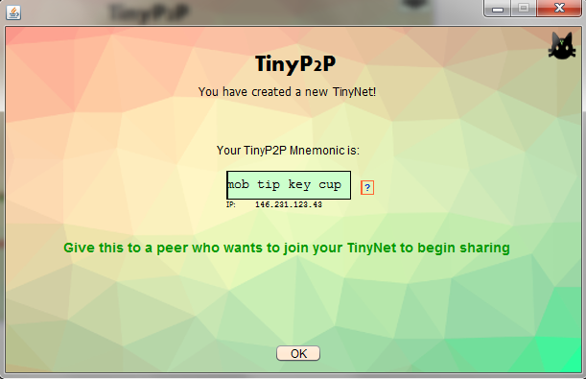
Creating a new TinyNet

Slide 10
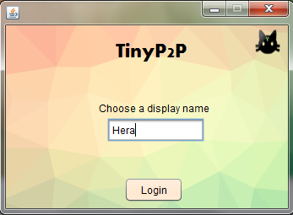
Logging in
Currently no password
required for login
Password would allow for
file synchronization
Now just a display name
Underlying DHT (TomP2P) to be extended to allow for password protected TinyNets

Slide 11
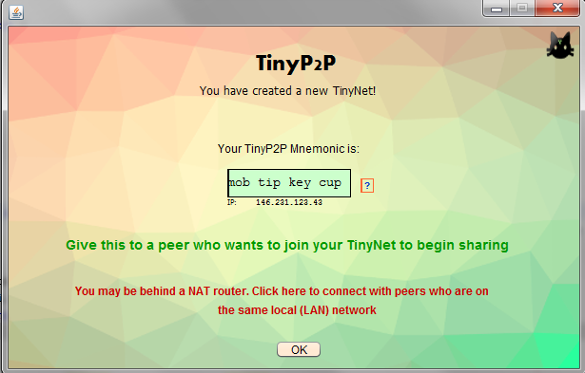
Dealing with NAT

Slide 12
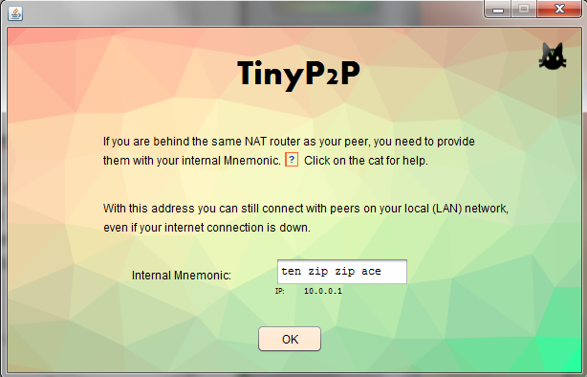
Dealing with NAT

Slide 13
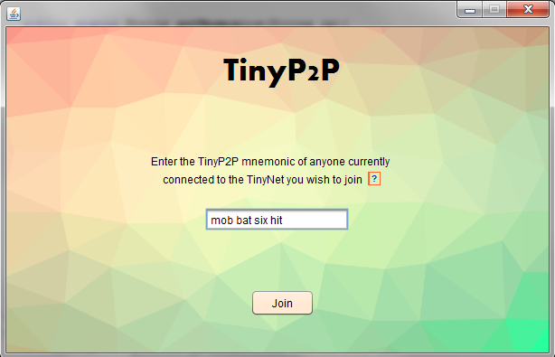
Joining a TinyNet

Slide 14
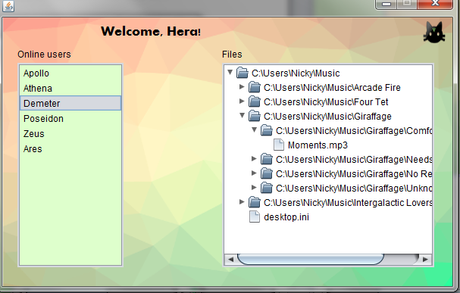
Main Window (Work in progress)

Slide 15
TinyP2P
Ad-hoc friend-to-friend networks
Purely decentralized
Aims to be easy to use even for novice computer users
Security can be improved

Slide 16


